Slide 1



The MCMUA & The County Office of Health Management
Working Together to Find Solutions to Illegal Dumping

Slide 2
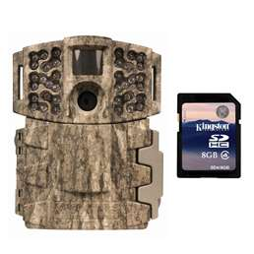
Moultrie Game Spy Camera
There are many different cameras available. Check to see which camera is best suited to meet your needs before making a purchase. They are affordable and easy to use.

Slide 3
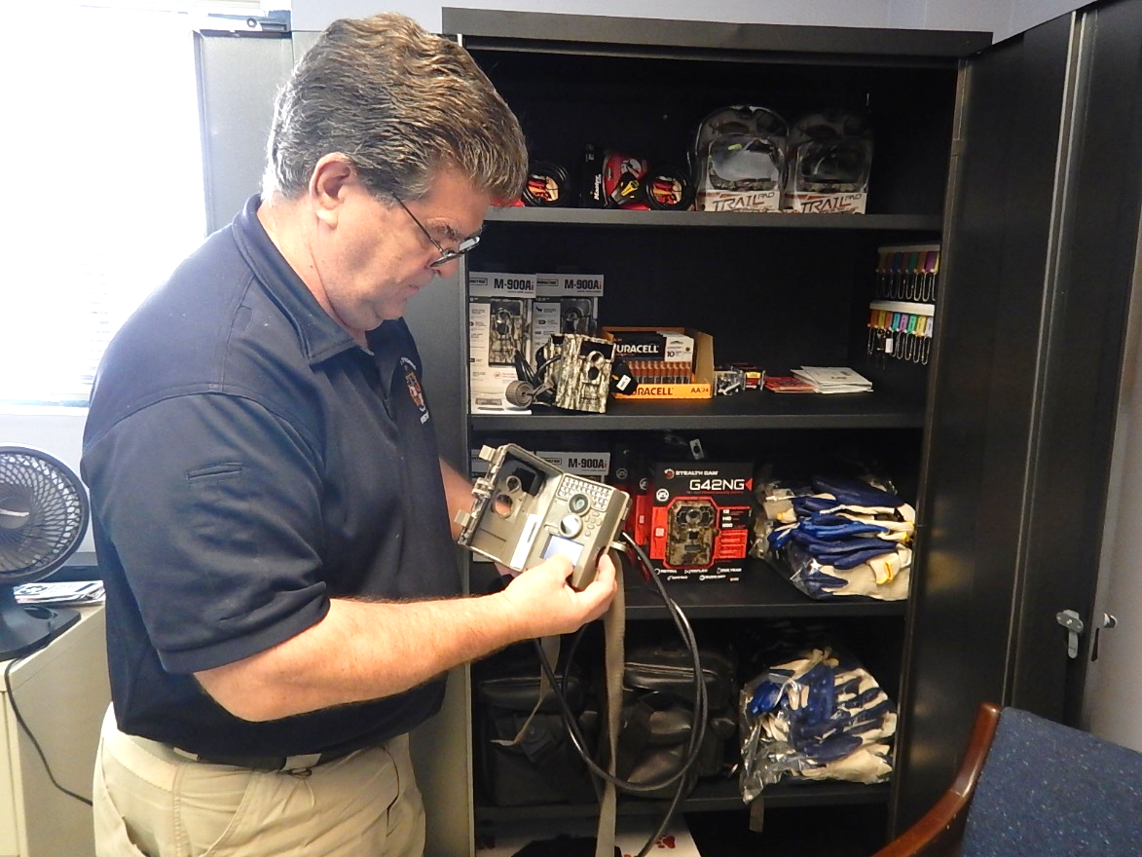
10 cameras were purchased through our Clean Communities Grant. We loan them out to municipalities to assist in finding those who are responsible for illegal dumping.

Slide 4
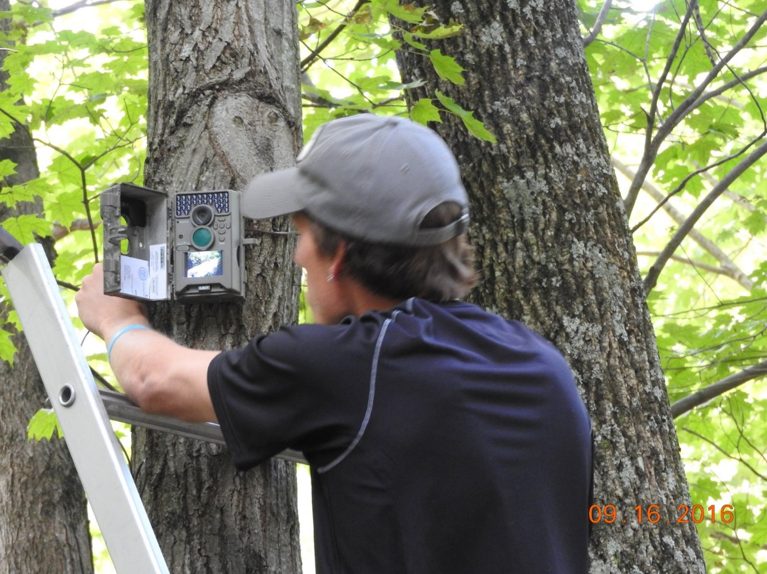
The cameras are mounted on trees and not readily noticeable.

Slide 5
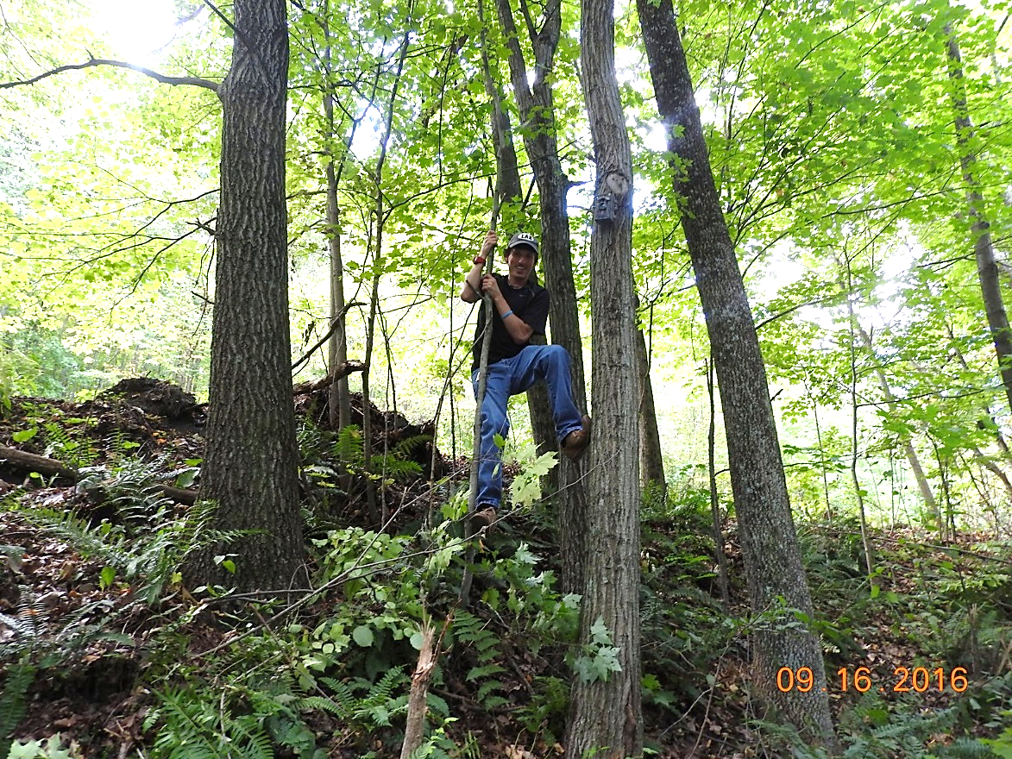
The camouflage cameras blend in well.

Slide 6
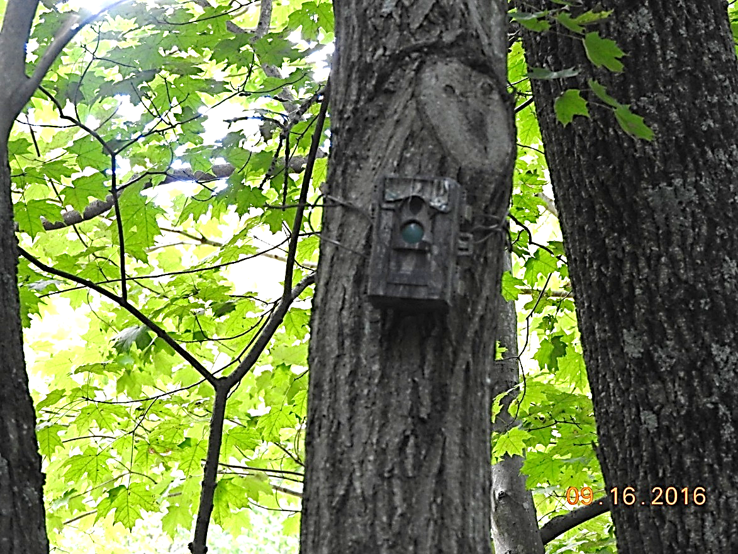

Slide 7
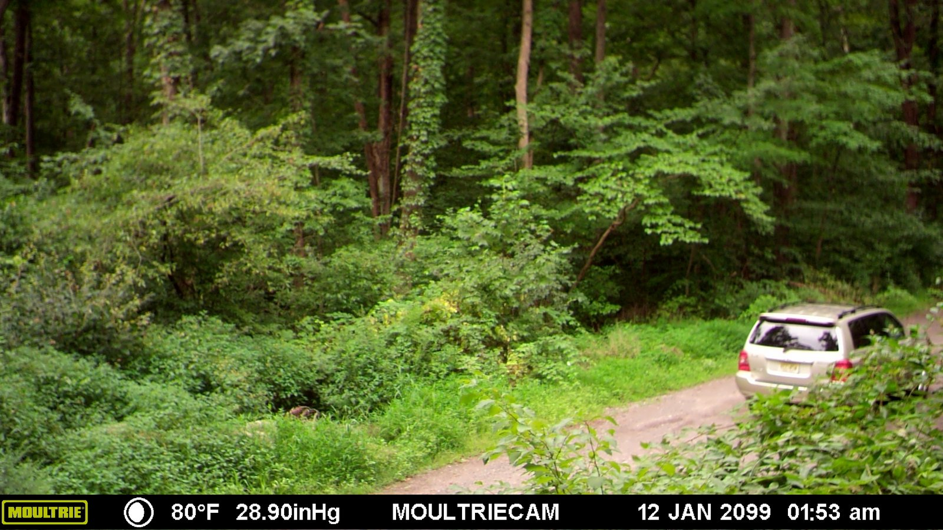
The camera films the car.

Slide 8
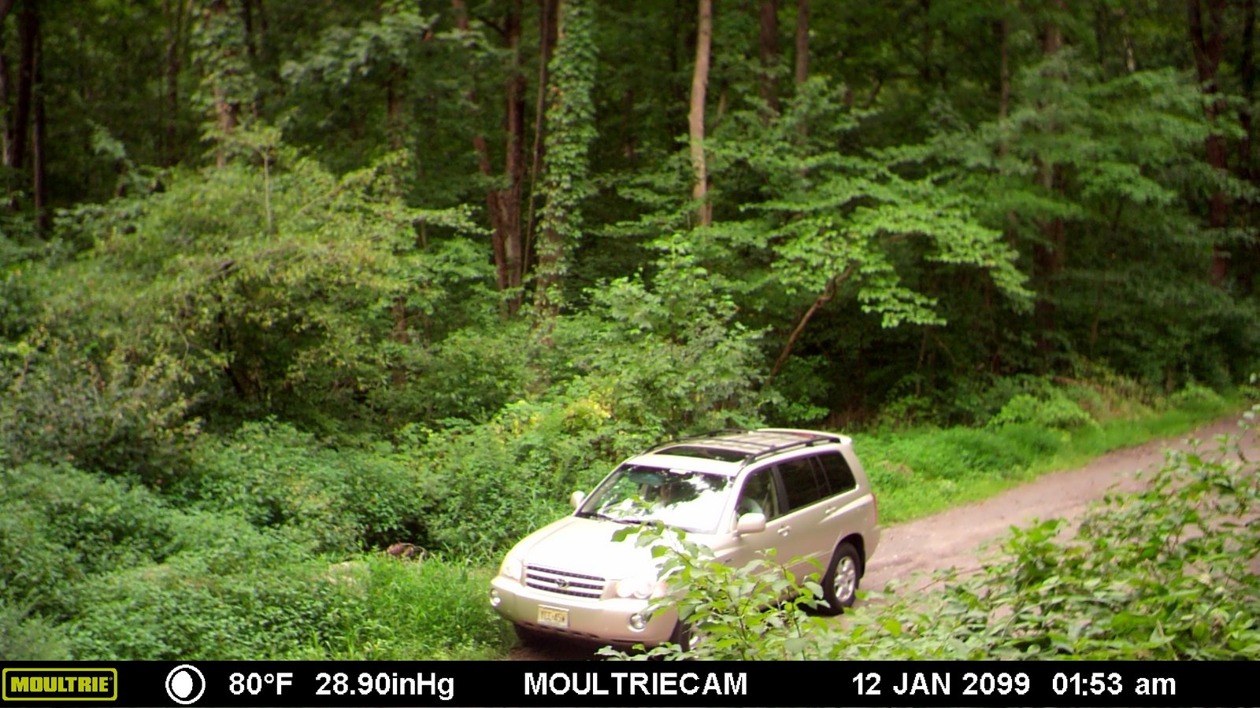
Car stops along road.

Slide 9
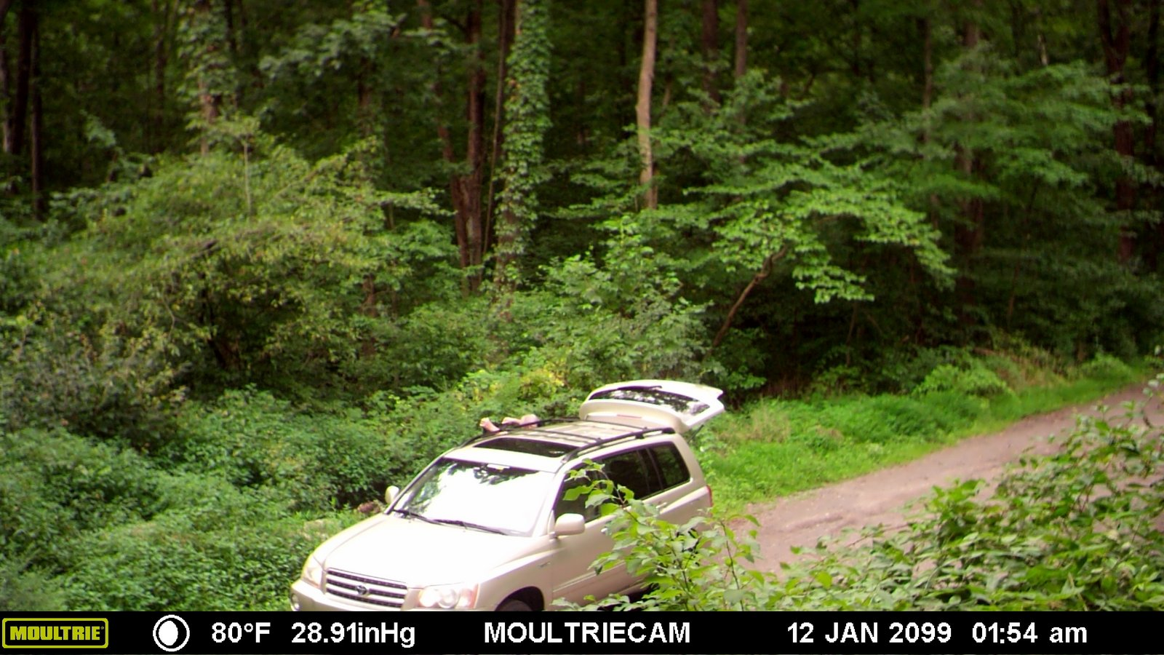
Resident opens hatch of car and begins dumping!

Slide 10
Resident dumping contents of bags next to car!

Slide 11
The Camera clearly provided the necessary information.

Slide 12
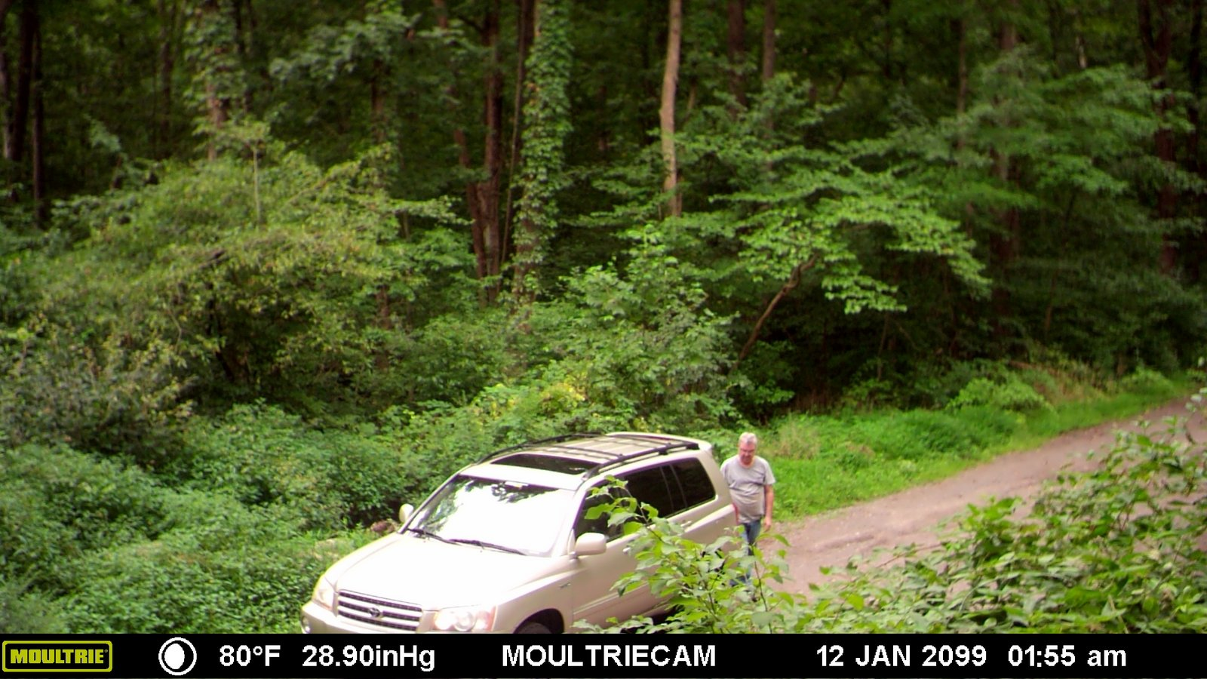
SMILE! We are taking your picture!

Slide 13
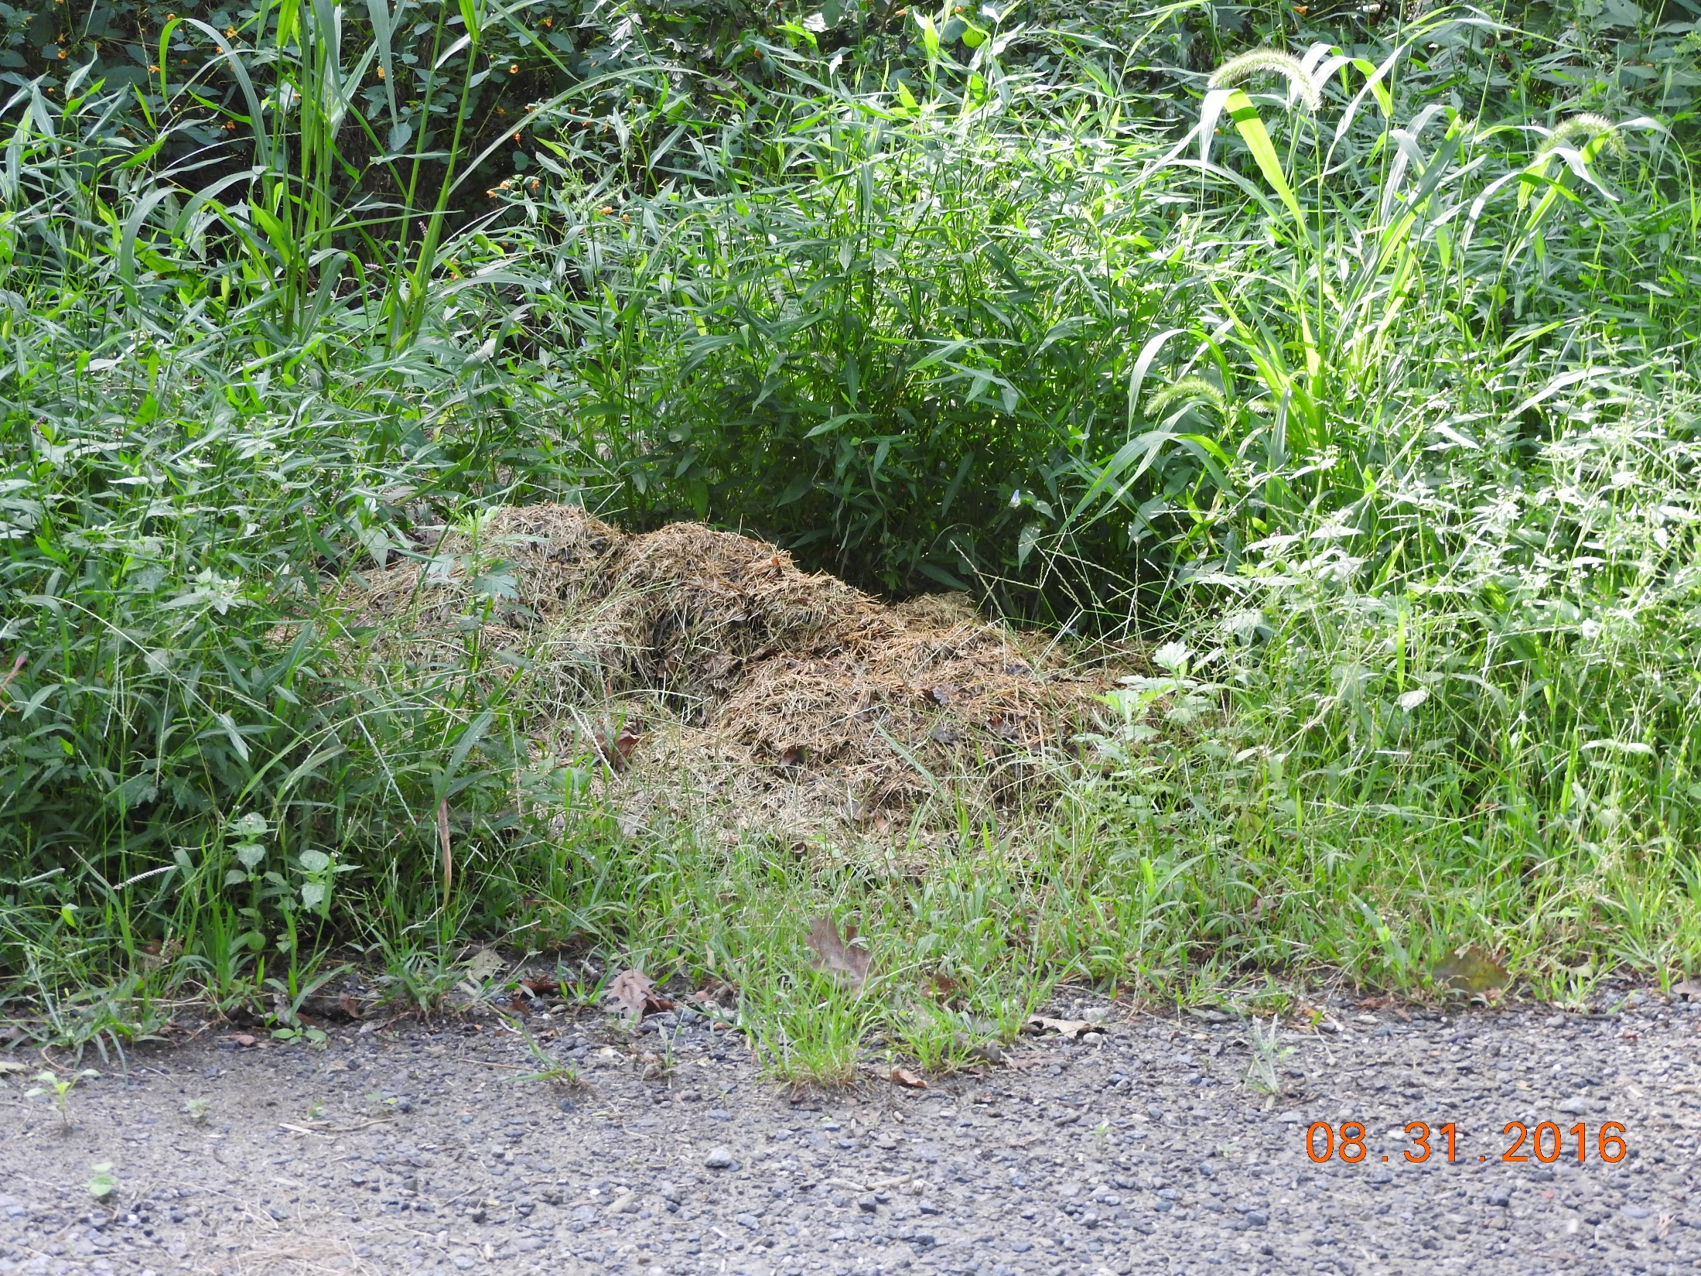
A local resident dumped vegetative waste (grass clipping and yard waste) in a remote area near State park land.

Slide 14
Illegal dumper – Ray R., resident of Budd Lake, was identified and fined!
The County Office of Health Management issued an N.O.V. with a penalty of $5,000.00.

